Slide 1
Comprehensive Digital Marketing For Britannia

Slide 2


Slide 3
BRAND STUDY OF BRITANNIA

Slide 4
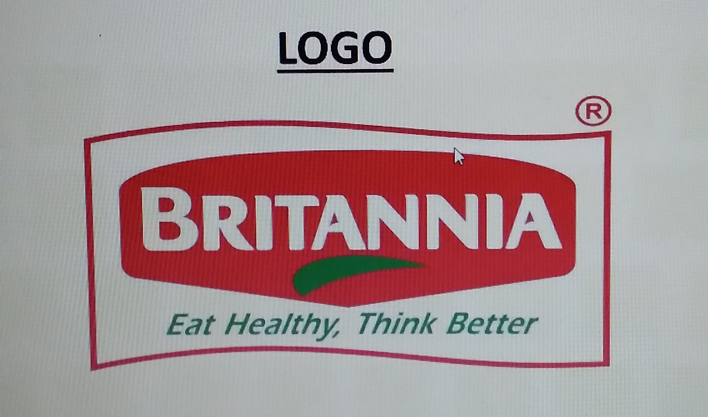
LOGO OF BRITANNIA

Slide 5
MISSION OF BRITANNIA: Britannia industries is a manufacture and marketing of bakery and dairy products. Britannia mission to meet or where possible, exceed the expectations of our diverse clients base with flexible, innovative solutions of highest quality that adhere to safe, ethically sound and environment friendly codes of practice.

Slide 6
USP OF BRITANNIA: unique selling proposition. India’s very own bakery and dairy products brand that is trusted for it’s quality. It’s biggest USP is their brand image as they are in the Indian market since 1891 and has a very good reputation.

Slide 7
BRAND TONE AND IDENTITY: Britannia was traditionally associated with the colors red and green was introduced yellow to the palette to represent the excitement that Britannia brought to food. Britannia the laughing cow logo will now be part of all integrated marketing, communication touch points for across packaging.

Slide 8
SMART GOALS:
Increase sales and profits in next three quarters.
Needs to focus on metrics that are consistent with the values and interests of the wider stakeholders.
To attains the set goals on terms of both financial resources and infrastructure.
Under the relevant goals Britannia company should focus on scope and timeliness of project.
The goals set by Britannia should be clearly specified minutely.

Slide 9
KPIS OF BRITANNIA: Return on investment. Market share. Cost per acquisition. Brand equity. Coast per lead.

Slide 10
AUDIENCE PERSONA: Make enjoyable food , healthy and accessible to all people anytime everyday. For the past 100 years Britannia has produced a variety of goods. It’s focused on the elderly and the children who will follow them Low income individuals and families are the largest market for the Britannia Tiger while the families are the target audience for the Britannia Marie gold. Use a mix of demographic and psychographic segmentation strategy considering the population variables such as age ,social class, education level , income level, marital status and occupation tO serve different customer groups accordingly.

Slide 11
COMPETITOR ANALYSIS: Parley: Parley agro is an Indian company that owns frooti,Apple,Parley G. Parley being the Britannia’s biggest competitor. Amul: It is an Indian dairy cooperative. It sells ice cream ,Lassi and dairy products. Nestle: Products include baby food ,medical food.

Slide 12
SWOT ANALYSIS: Strengths: Around 120 years in the industry. Indian’s must trusted brand with strong brand recall. Wide range of bakery products Major share in biscuits industry. Innovative products for health conscious people like oats and parridg etc.

Slide 13
WEAKNESS: Lower market share in dairy segments. Heavy expenditure on advertisadvertisement and marketing. Similar products produced by many companies means high brand switching.

Slide 14
OPPORTUNITY: Increase in purchasing power of people in India. Product line extension . Expansion in other countries.

Slide 15
THREATS: lower price offering competitors. Local fairies and bakeries. Inflation can cause fall in sales and revenue. Rise in.cost of row material.

Slide 16
SEO AND KEYWORD RESEARCH

Slide 17
SEO AUDIT OF BRITANNIA

Slide 18
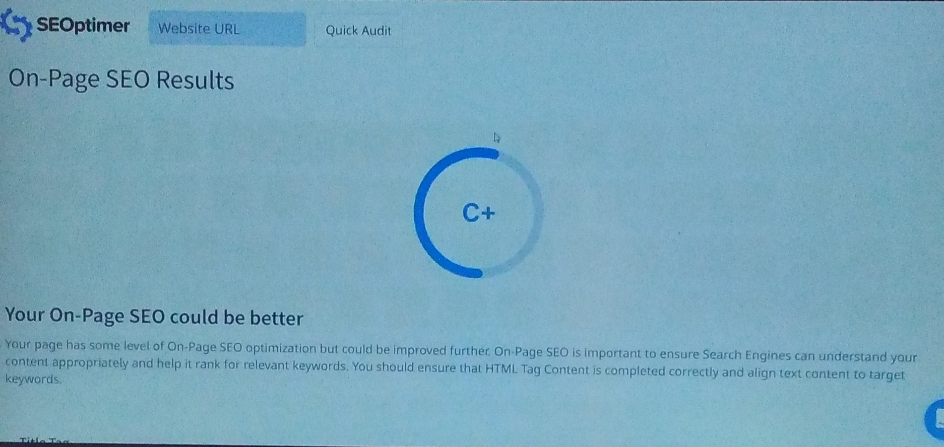

Slide 19
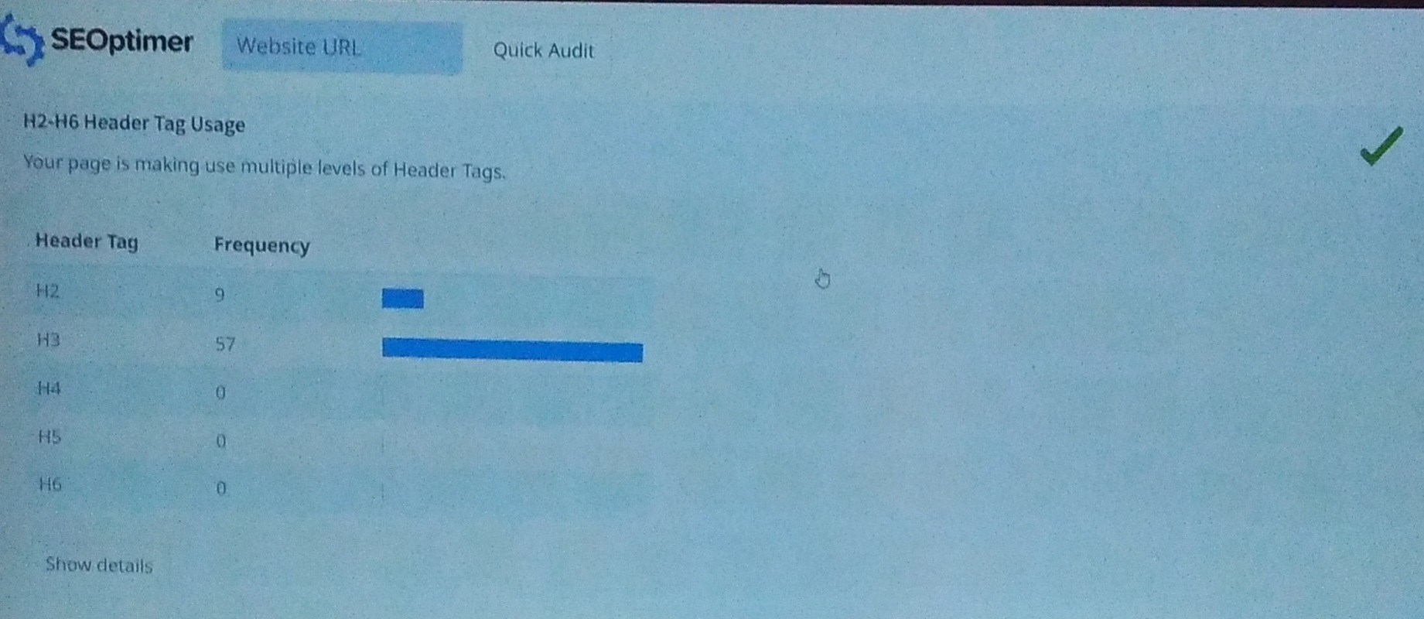

Slide 20
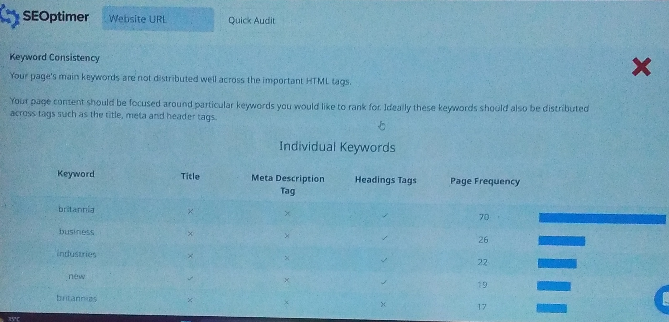

Slide 21
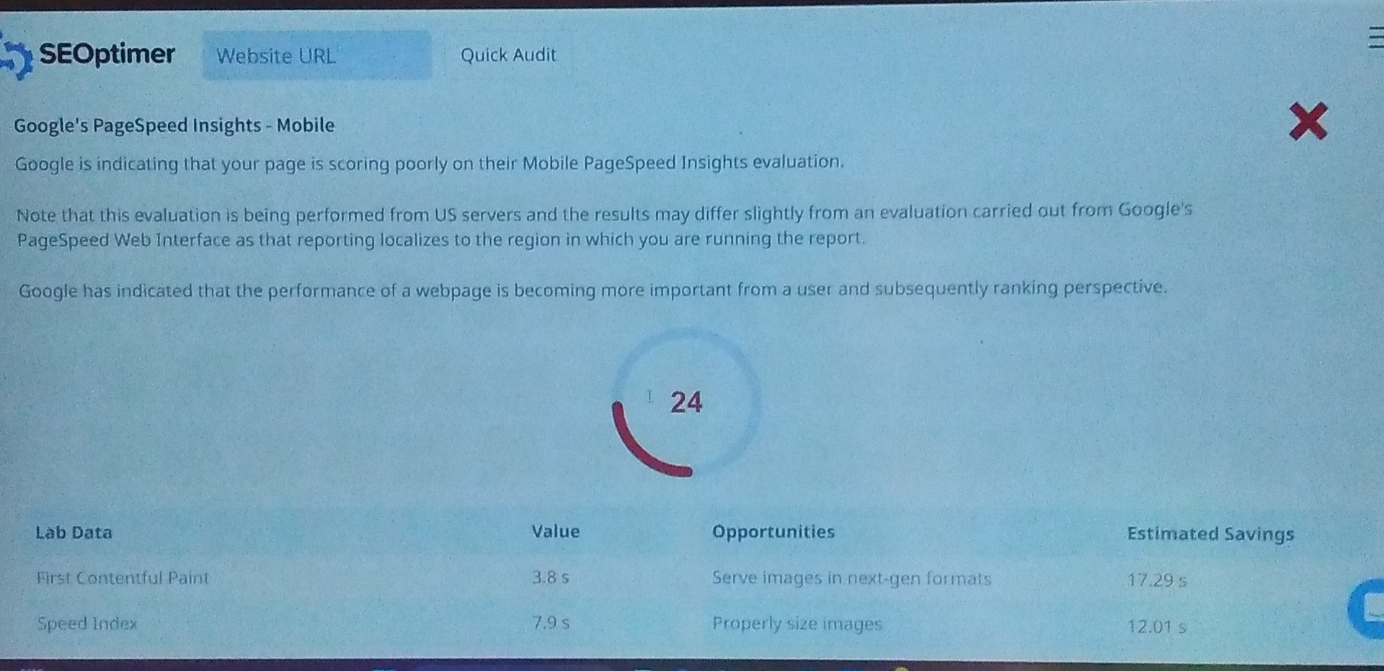

Slide 22
KEYWORD RESEARCH OF BRITANNIA

Slide 23
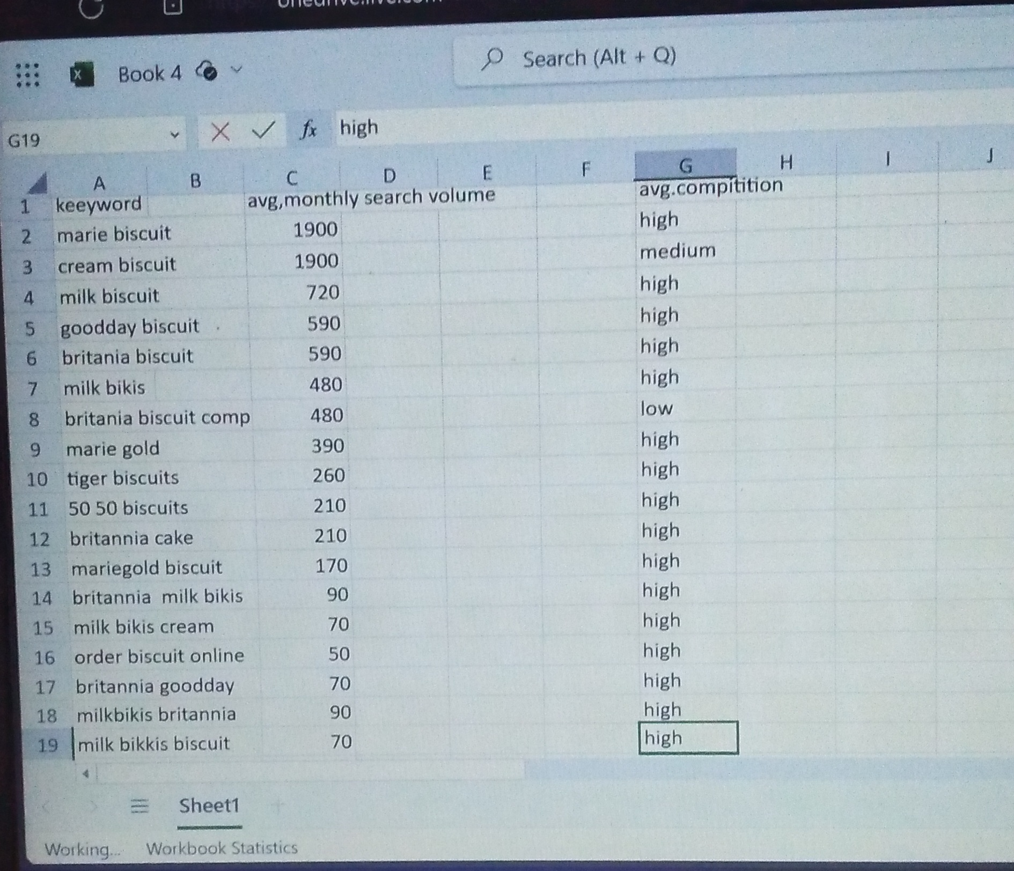

Slide 24
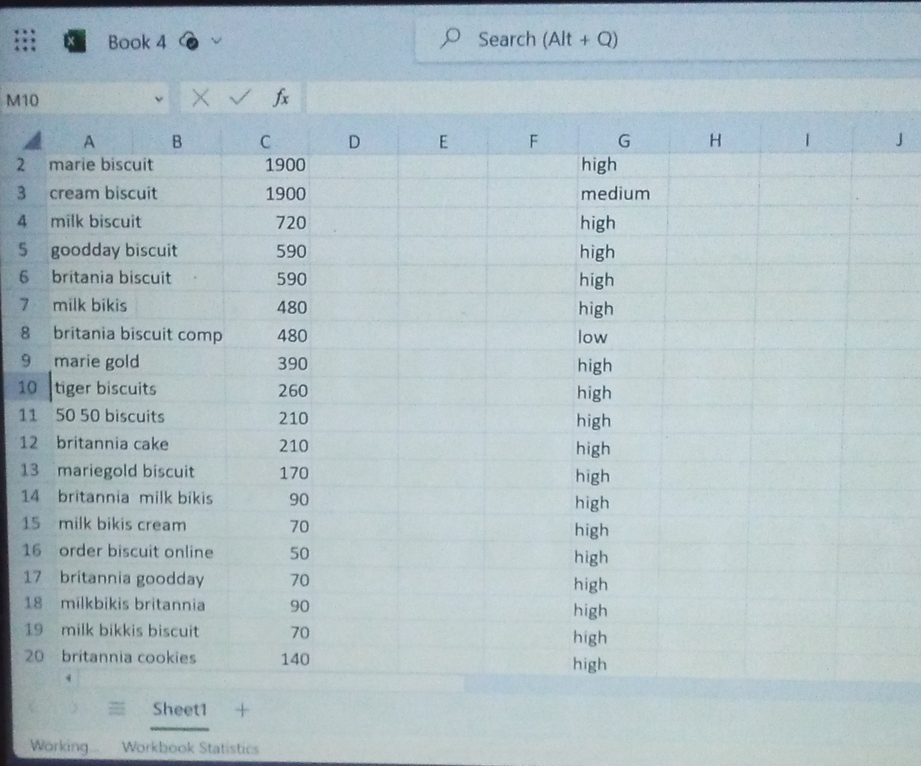

Slide 25
COMPETITOR ANALYSIS
.. OF
BRITANNIA

Slide 26
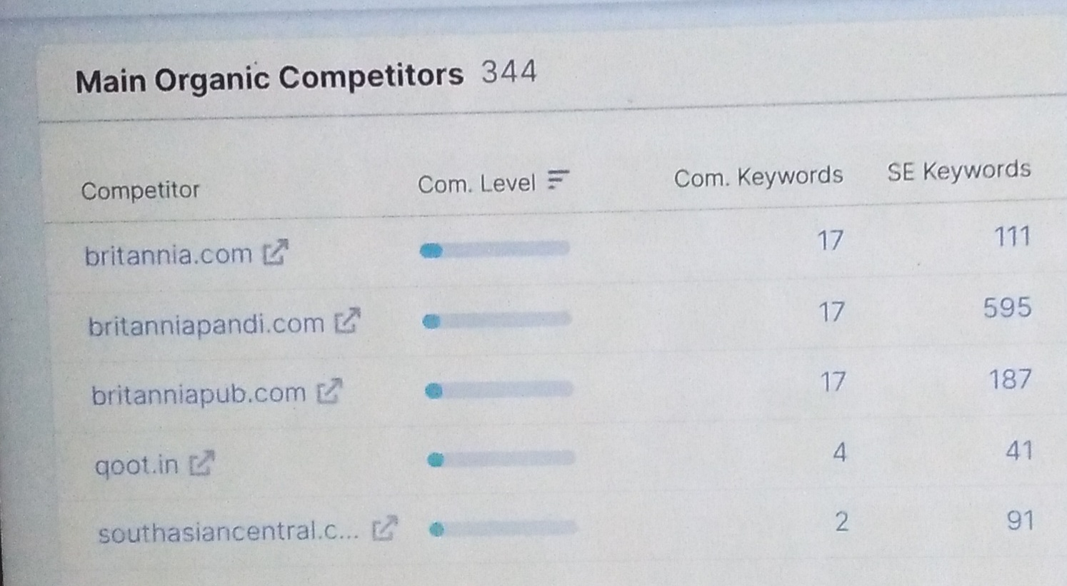

Slide 27
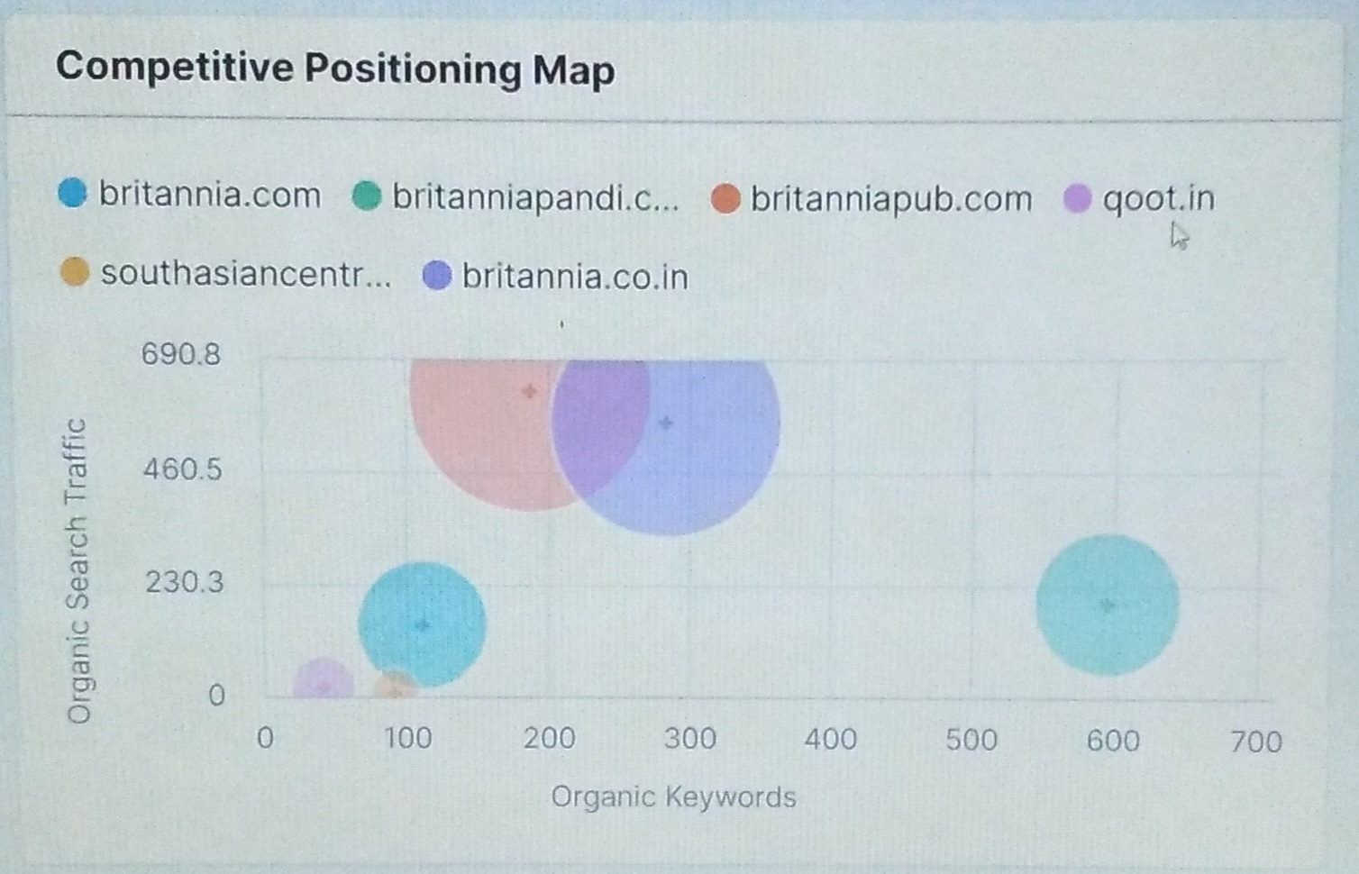

Slide 28
ON PAGE OPTIMIZATION OF BRITANNIA

Slide 29
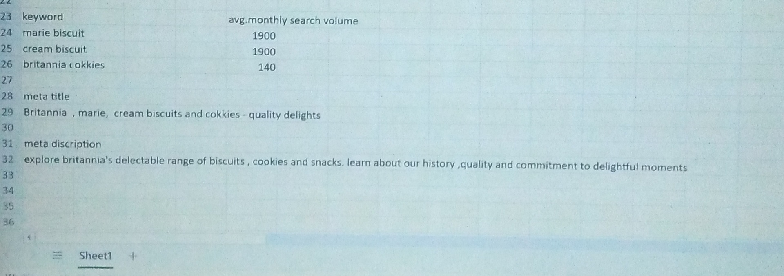

Slide 30
CONTENT IDEAS AND MARKETING STRATEGY

Slide 31
CONTENT CALENDAR FOR BRITANNIA

Slide 32
Date | Platform | Content type | Theme | Strategy | Aim | Idea behind
Oct 16 | Instagram | Image | Fall delights | Seasonal Promotion | Promote Britannia Fall product | Share a Britannia ‘s Fall products
Oct 18 | Facebook | Blog post | Seasonal Recipes | Informative content | Share autumn recipes using Britannia products | Publish a blog post with delicious Fall recipes and usage of Britannia biscuits

Slide 33
Oct 20 | Instagram | Vedio | Behind the scenes | Brand transperency | Showcase the production process | Offer a behind the scenes vedio tour of a Britannia production facility
Oct 24 | Facebook | Info graphic | Nutritional Benefits | Educational content | Highlight product,Nutrition and benefits | Share an info graphics showcasing the Nutritional values of Britannia products
Ocr 28 | Instagram | Recipe | Recipe of the week | User Engagement | Encourage users interaction | Share a recipe using Britannia biscuit

Slide 34
Content ideas and marketing strategies Challenges faced

Slide 35
Content diversity: Britannia offers a wide range of products and creating diverse, engaging content for each products can be challenging. It’s essential to keep content fresh and relevant. Competitive marketing: the food industry is highly competitive standing 9ut from competitors and reacts unique content can be challenging

Slide 36
Lessons learned: content calendar: A well structured Content calender is required Data analysis: regularly analyze data to understand the performance of different content pieces. Adjust your content strategy based on performance metrics.

Slide 37
CONTENT CREATION AND CURATION

Slide 38
Content format 1: Recipe vedios content idea:create short recipe videos featuring. Britannia products to engage audiences interests. Social media post: chocolate Marie tiramisu caption: try our chocolate Marie tiramisu CTA : share your Britannia recipe creation with us.

Slide 39
Content format 2: health and wellness tips content idea: share informative and educational content related to health and wellness on the nutritional aspects of Britannia products. Social media post: nutri choce digestive bbiscuit. Caption : taking care of your digestive health is essential. CTA: swipe to see our tips.

Slide 40
Contest format 3: user generated content Content idea: encourage customers to share their experience and creative ideas using Britannia products. Social media post: #Britannia delights challenge Capiton: join the # Britannia delights challenge CTA: use #Britannia delights for a chance to be featured.

Slide 41
INSTAGRAM POST ON BRITANNIA

Slide 42
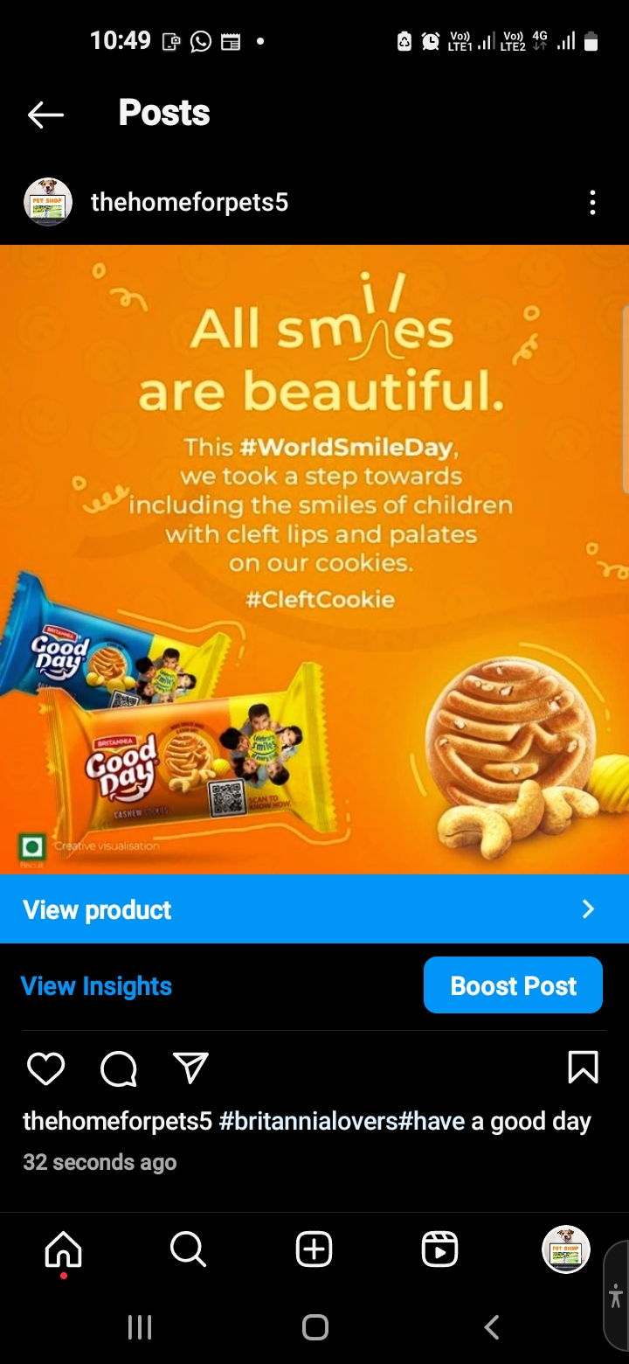

Slide 43
Team Rules and contribution : V.poojitha (team lead) Brand research,competitors analysis. G.madhuri (team member) Audience persona,SEO audit. y.sailaja (team member) KEYWORD RESEARCH,on.page.optimization v.sravanthi post creation ,design/vedio editing

